Slide 1
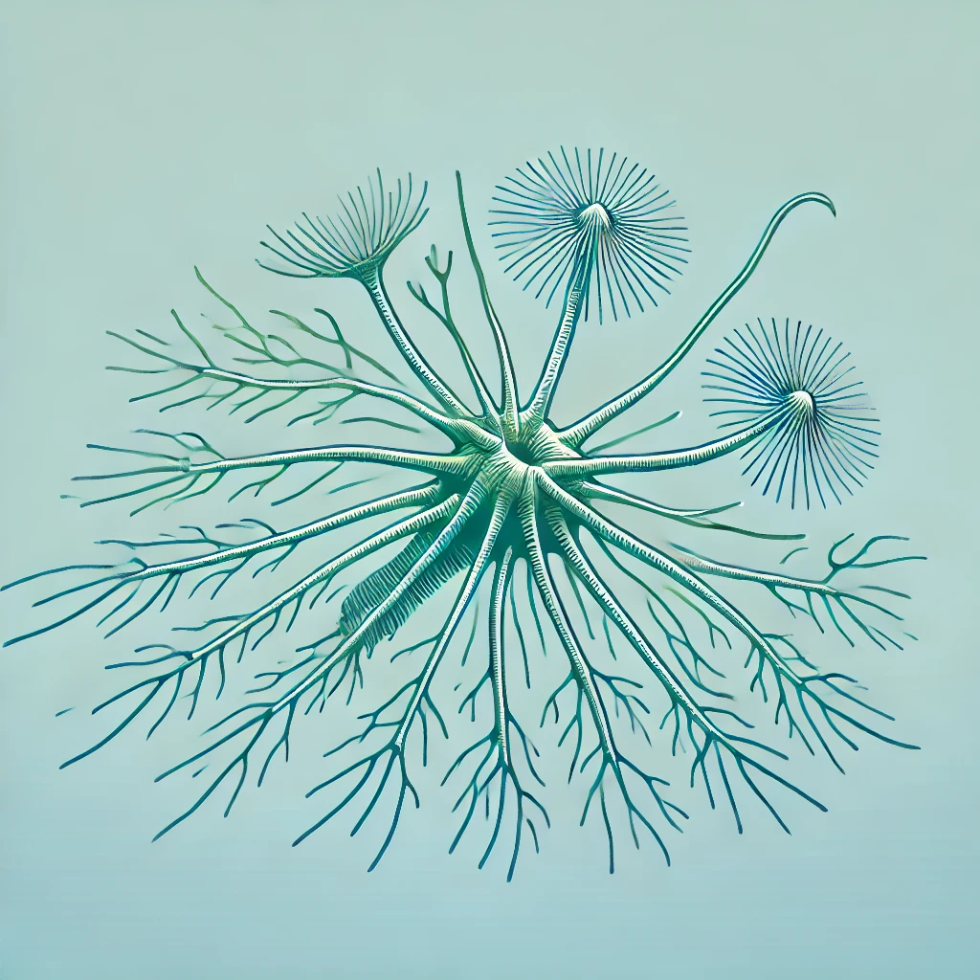

Identify one epibiont (bryozoan or hydrozoan)
via microscopy on a blade
Extract species DNA (Dneasy Blood and tissue)
Ask Dundee what WGS extraction method is desired and cost
Extracted DNA with Qubit to assess concentration &
Nanodrop to check quality
SPECIES IDENTIFICATION
Run on gel to ensure fragment size is as expected
e. g. x# different Eppendorf, isolate species from each and determine if same species or different
PCR amplification of CO1 gene using generic primers
Sequence amplified CO1 gene region (Dundee)
BLAST search of the sequence region to ID species
Assess genetic diversity
Build a phylogenetic tree to understand species relationships within the taxon
Output:
Database of biofouling species per taxon hydrozoa or bryozoa identifying which are most problematic
Species within a taxon are few <10
CLADE-SPECIFIC
Species within a taxon are plenty >15 : cost-dependent of WGS
Run on gel to ensure fragment size is as expected and DNA intact. Ask Dundee requirements
SPECIES-SPECIFIC
Consult the phylogenetic tree of e.g. hydrozoa to see the common link
Whole genome sequencing – Dundee: ask processing, alignment
Develop primers that target multiple related species.
Using generic markers: e.g. CO1, 18S, 24S
Including single nucleotide polymorphism to ensure specificity
Identify high copy number repeats – ask if Dundee do
Amplify target DNA and sequence (Dundee)
Design species-specific primers targeting repeat regions DNA regions.
– LINUX has repeat finder programmes – ask martin why non-coding region is being targeted – James Cotton cc
Confirm clade-level specificity and group genetic diversity
Design species-specific quantitative assays (qPCR / ddPCR)
Decide if focus on species-specific or broader taxonomic group
Align sequences from conserved loci (CO1, 18S, 24S) within clade
Design primers to amplify only desired species group
Validate designed primers
Test with known +/- samples to confirm specificity
Optimise annealing temperature and reaction conditions
Filter plankton eDNA from seawater
Extract DNA and amplify with tailored primers
Primers will have species / group specific tags so all primers go into same sample to detect all e.g. hydrozoan species
PROJECT AIM
Perform qPCR / ddPCR
Quantify target species or clades within a sample
Normalize results to environmental conditions
DS validates primer specificity by ensuring only target regions amplified
Amplify target DNA (species-specific or clade-level) using designed primers (PCR)
Multiple replicates and +/- controls to detect contamination / non-specific binding
Sequence amplification product using deep sequencing (MiSeq/illumina/NextSeq)
DEEP-SEQUENCING VALIDATION
Generate high-throughput sequence data for libraries
Libraries are quantified prepared/purified sample amplicons
Validate amplified DNA aligns with target species / clade specifically
Identify off-target amplification / biases / cross-reactivity
Refine primer specificity

